Slide 1


Projectiles’s Project
Mechanics 2

Slide 2

01
Rules

Slide 3

X-Direction
Y-Direction
X°=X°_{o}
X=X_{o}+X°_{o}*t
Y°=Y°_{o}-g*t
Y=Y_{o}+Y°_{o}*t-0.5*g*t²
Y°²=Y°_{o}²-2g[Y-Y_{o}]

Slide 4
02
Code

Slide 5
Notes:
VX means the initial velocity on X-axis
VY means the initial velocity on y-axis
X means the total distance covered on X-axis
Y means the total distance covered on Y-axis
XF means the final velocity on X-axis
YF means the final velocity on Y-axis

Slide 6
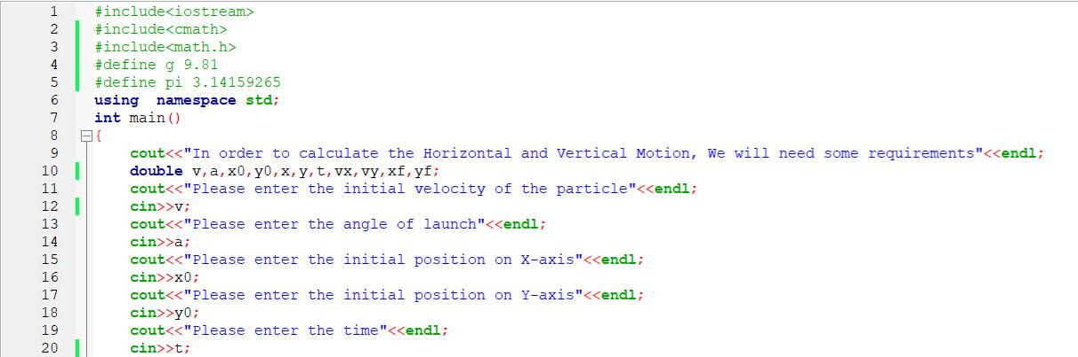

Slide 7
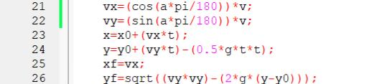

Slide 8
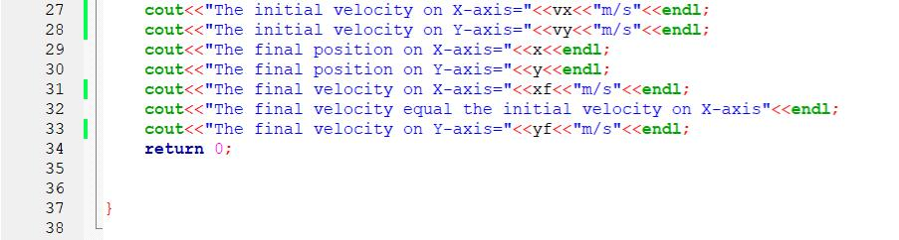

Slide 9
02
Example

Slide 10
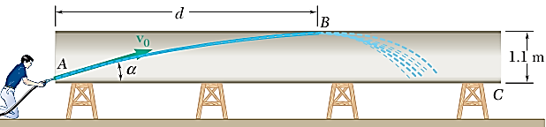
A worker uses high-pressure water to clean the inside of a long drainpipe. If the water is discharged with an initial velocity v0 of 11.5 m/s, determine (a) the distance d to the farthest point B on the top of the pipe that the worker can wash from his position at A, (b) the corresponding angle.
Example used from sheet 2 question 8

Slide 11
Question analyzing
The givens in the question
The requirements
The initial velocity =>V°_{o} = 11.5m/s
The max point on Y-axis =>Y =1.1
The maximum point on X-axis
The angle of launch

Slide 12

By using the rules
X°_{o} = 11.5 cosθ
Y°_{o} = 11.5 sinθ
X=11.5 cosθ * t =>♤
1.1=11.5 sinθ * t- 0.5 *g*t² =>♡
0=(11.5 sinθ)²-2(9.81)(1.1-0) =>◇
11.5 sinθ= 4.645
Θ=23.6°
1.1=4.645 t – 4.905 t²
4.905 t² - 4.645 t+1.1 =0
t = 0.47s
Rules used here
♤=>X=X_{o}+X°_{o}*t
♡=>Y=Y_{o}+Y°_{o}*t-o.5*g*t²
◇=>Y°²=Y°_{o}²-2g(Y-Y_{o})

Slide 13
03
Run

Slide 14
The values that I will substituted with is
For initial velocity => 11.5 m/s
For angle of launch => 23.6 °
For initial position on X-axis => 0
For initial position on Y-axis => 0
For time => 0.47 s

Slide 15
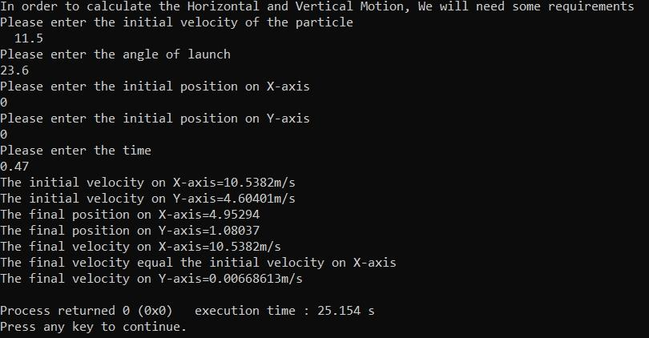

Slide 16
Thanks!
By Farida Waheed
Under Supervision of Doctor Abdallah
Communication and Computer Engineering Department

